Slide 1
Development of an AI Agent for Research Paper Analysis and Question Answering
Roshini Talluru
Tushar Jayendra Mhatre
Rahul Kataram
Supervised By
Dr. Theodore Trafalis
Apr 30th 2025

Slide 2
Problem Statement and Solution
Problem Statement: With the overwhelming volume of scientific research papers publishing daily, the contextual analysis is a major bottleneck for researchers.
Existing Solutions: AI tools like ChatPDF, SciSpace, ScholarAI, and ExplainPaper offer document querying and summarization.
Their major limitations: 1. Models deployed on cloud servers raise data privacy concerns.
2. Too computationally expensive to run on local systems.
Our Solution: A locally deployable AI chatbot for RAG (Retrieval-Augmented Generation) for contextual Q&A and FAISS for fast and semantically relevant document retrieval.

Slide 3
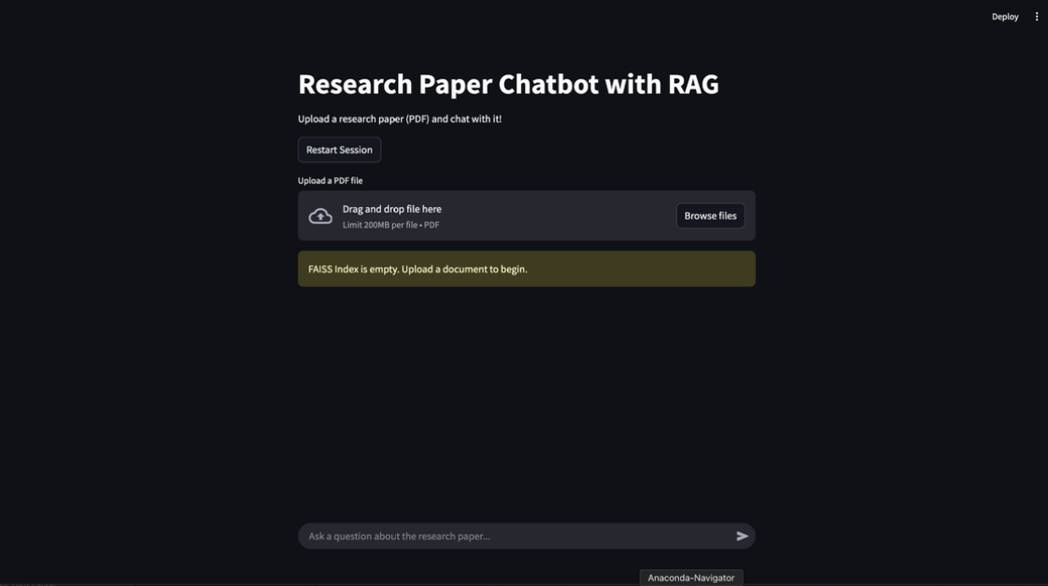

User Interface
U.I. Designed on Streamlit
Initial Summary

Slide 4

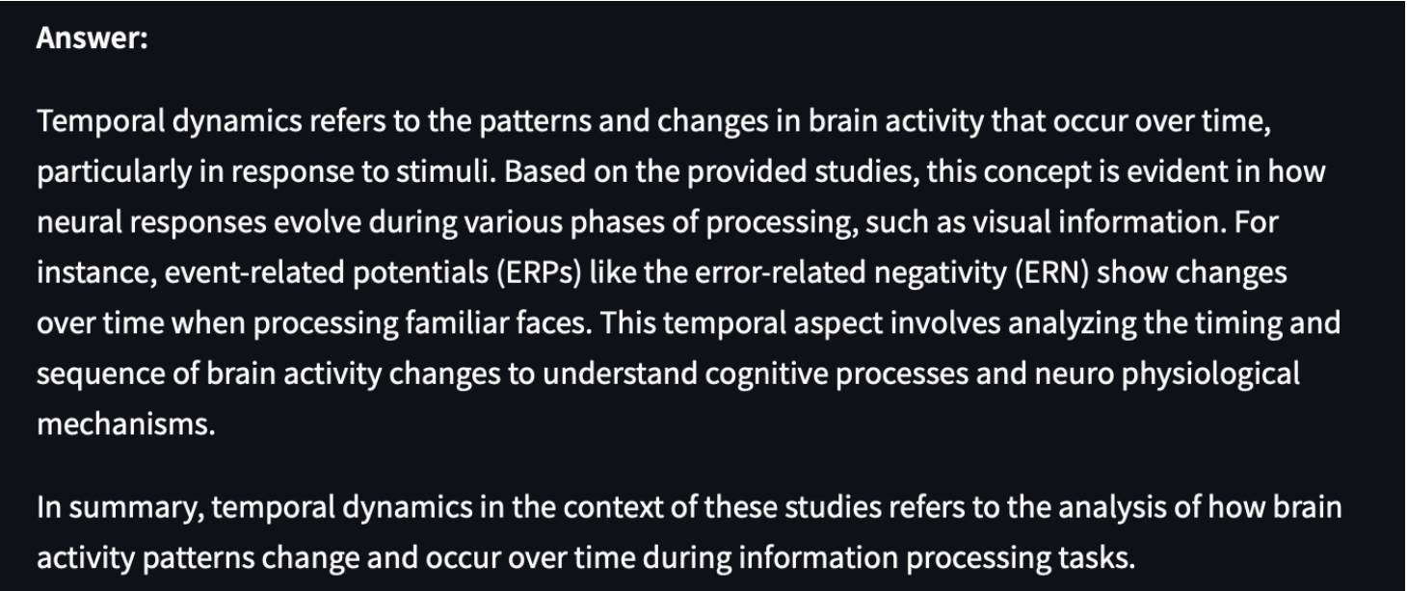
User Interface
User Input
Query Response

Slide 5
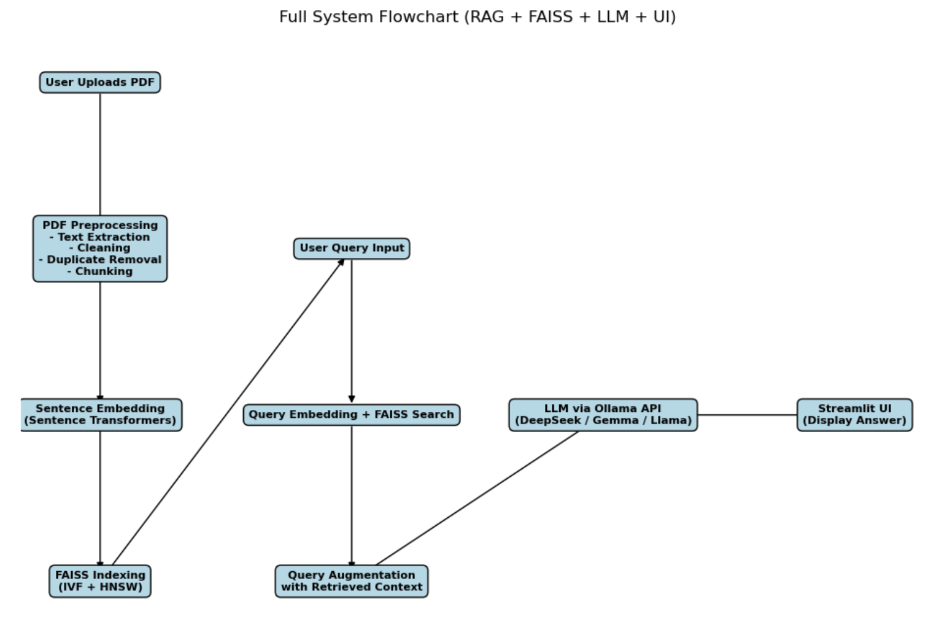
System Flowchart

Slide 6
Data Ingestion
A set of 15 research paper PDFs
Primary Sources:
arXiv (Machine Learning, CS)
PubMed (Biomedical)
Nature (Multidisciplinary Science)
Diverse Domains: Ensures robustness in retrieval/summarization
Key Features Extracted:
Text content
Metadata (titles, authors, references)
Structured summaries

Slide 7
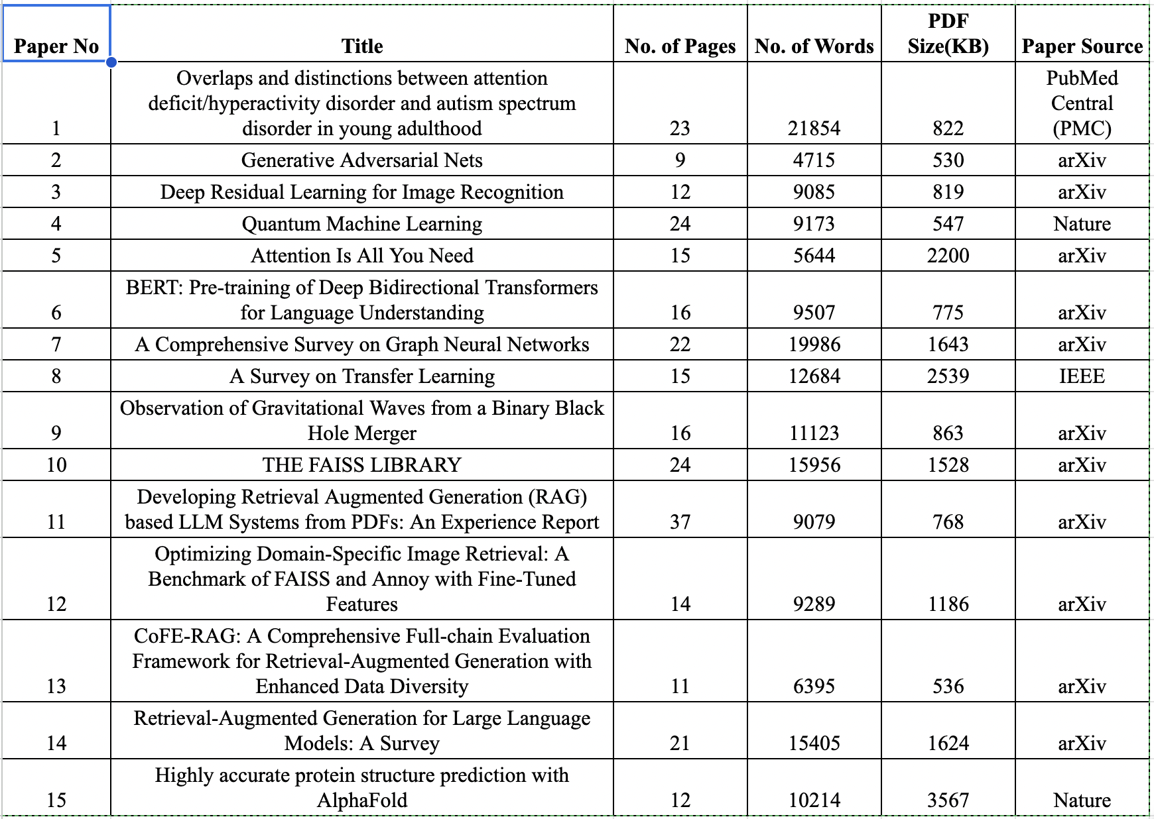
Dataset Preview

Slide 8
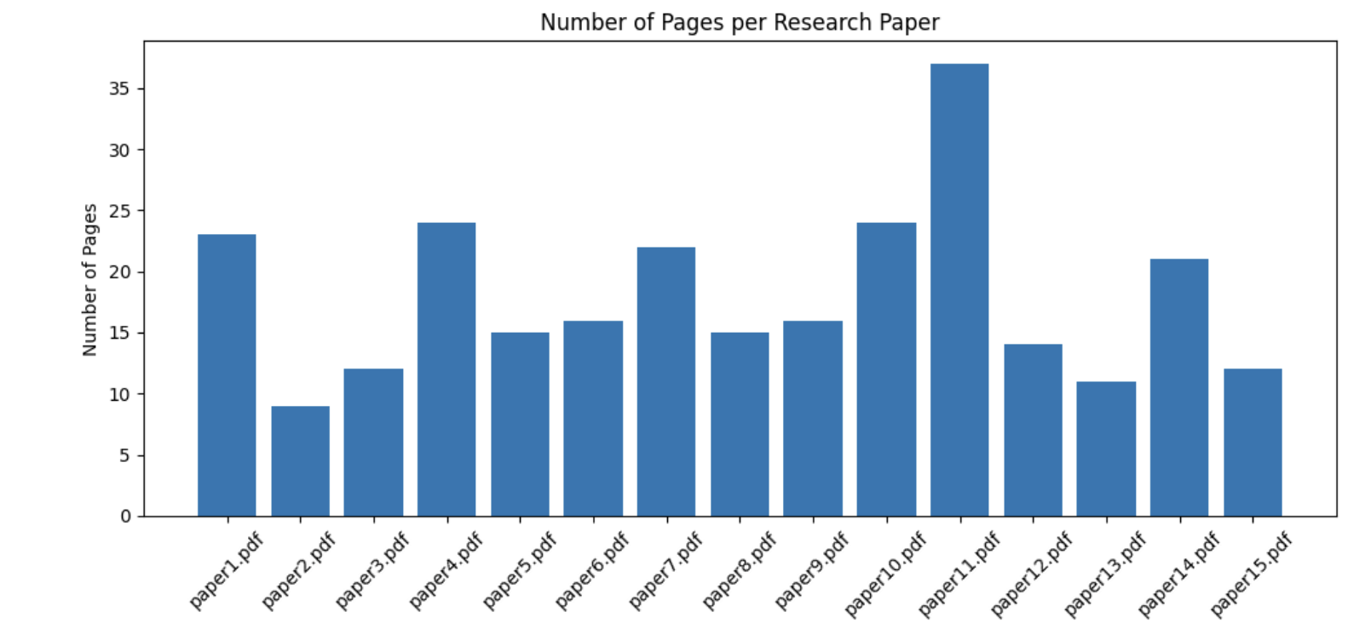
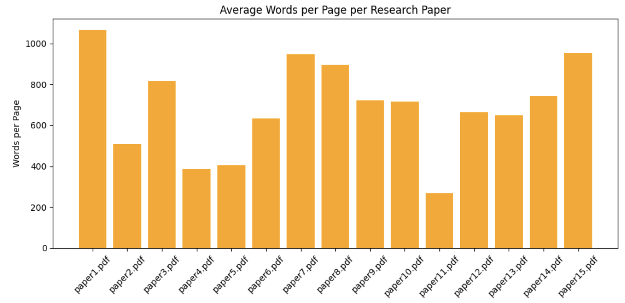
Data Exploration and Preparation
The selected PDFs vary widely in:
Length
Page count
Word density
Goal: Study how these factors influence parsing time.

Slide 9
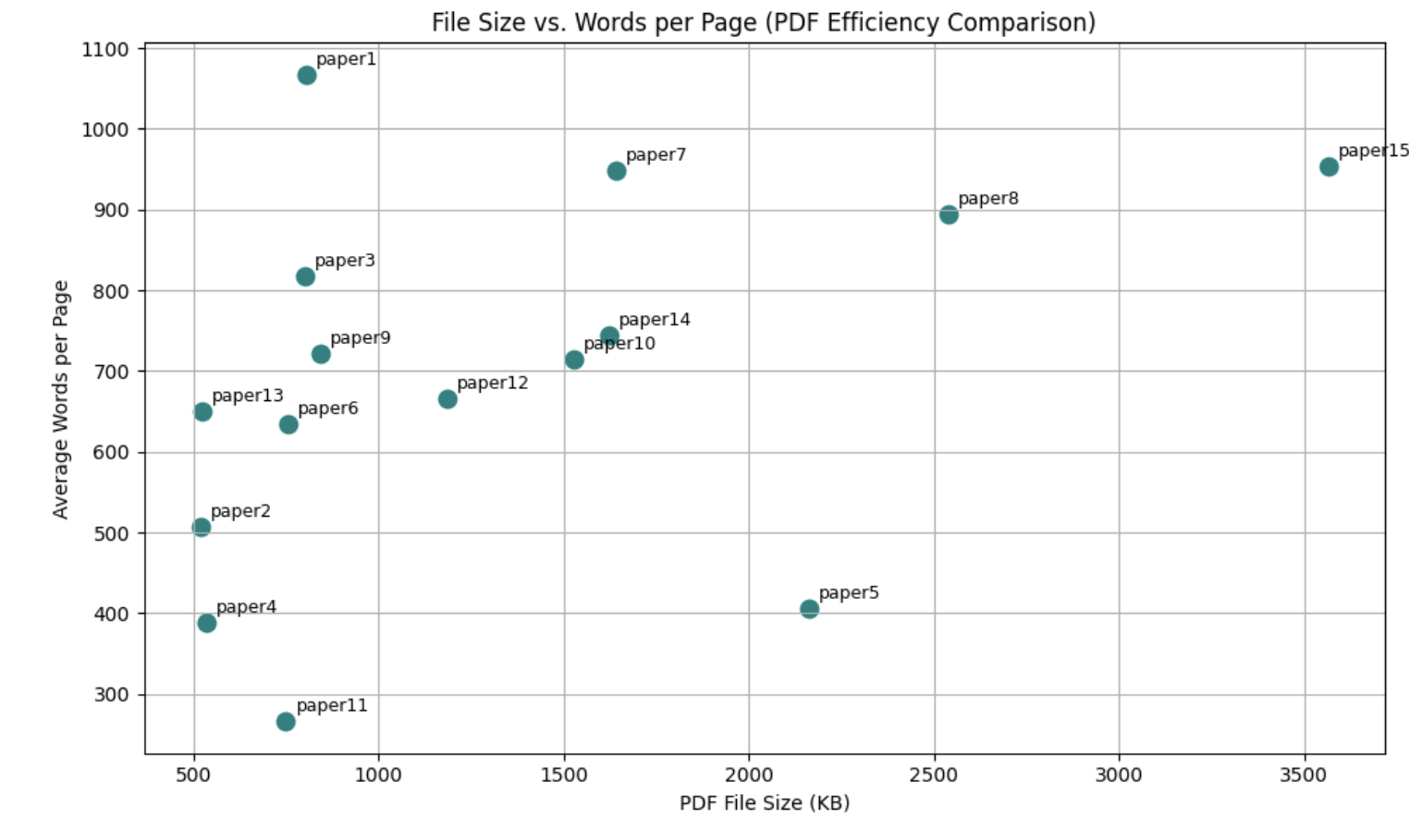
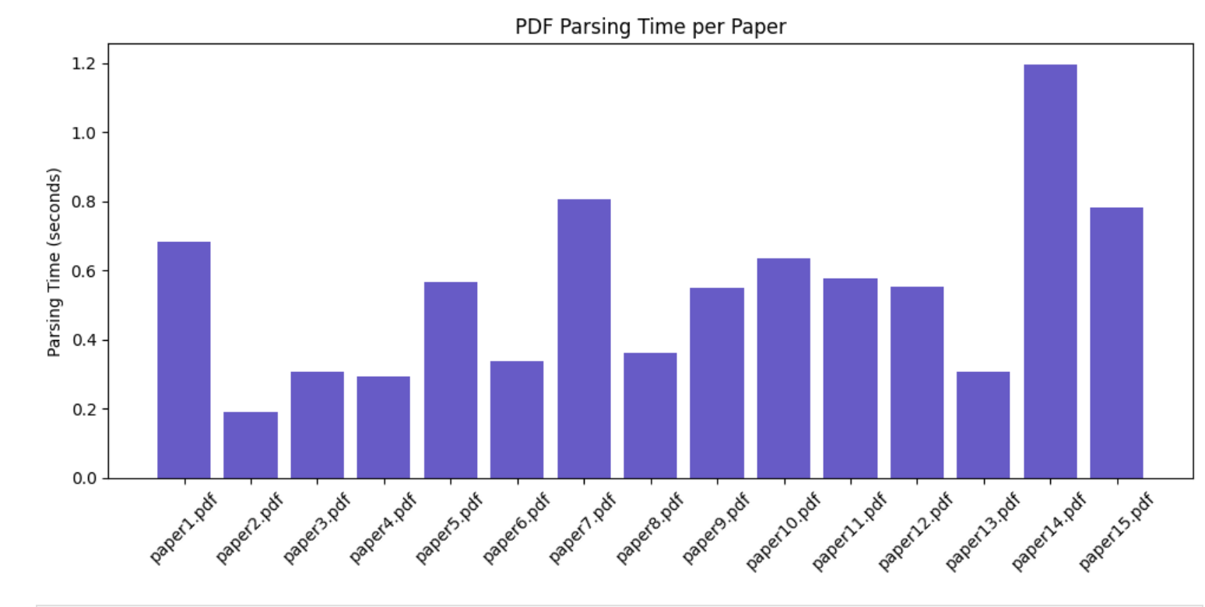
Data Exploration and Preparation
Investigates trade-offs between file size and average words per page.
Helps to understand document efficiency and potential processing challenges.
Observations:
High word density → longer parsing time.
File size alone doesn't directly impact parsing efficiency.
Example:
Paper 15 (3.5 MB) vs. Paper 1 (700 KB) have similar parsing times.
Paper 15 parses faster than Paper 14 despite being larger.

Slide 10
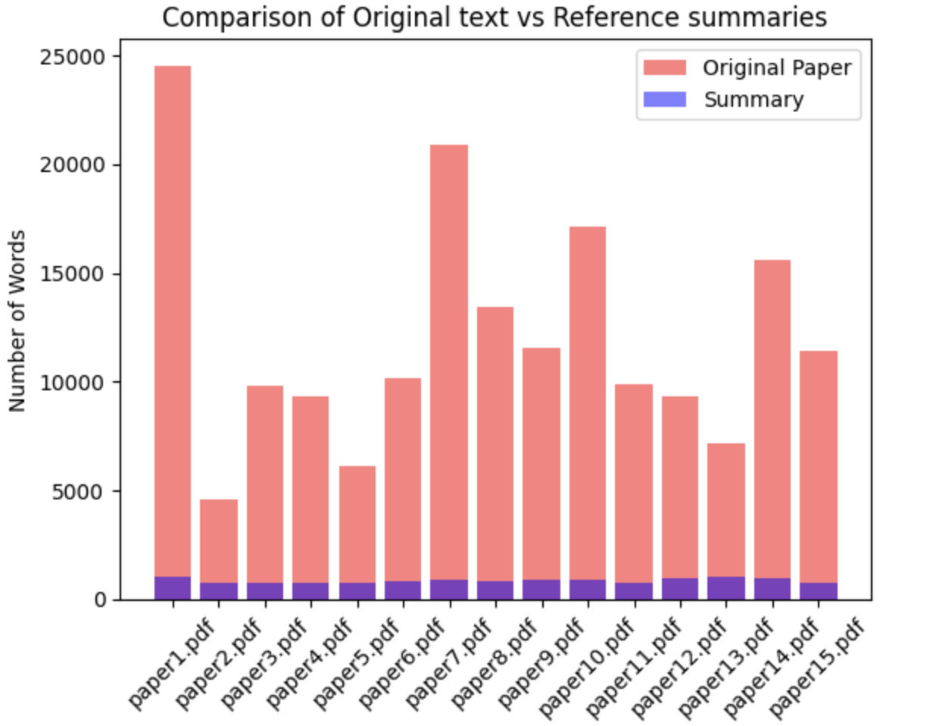
Data Exploration and Preparation
Summaries are significantly shorter than original texts.
Goal: Focus on key takeaways, avoiding unnecessary details.
Result: Achieve concise and informative summaries.

Slide 11
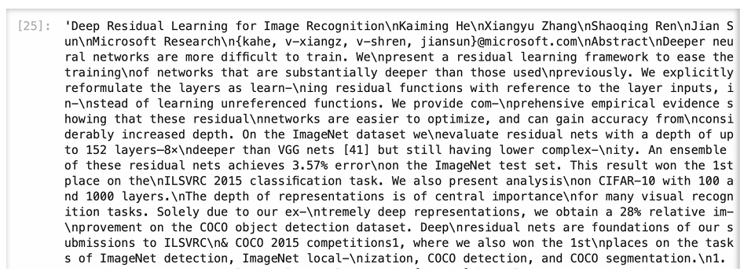
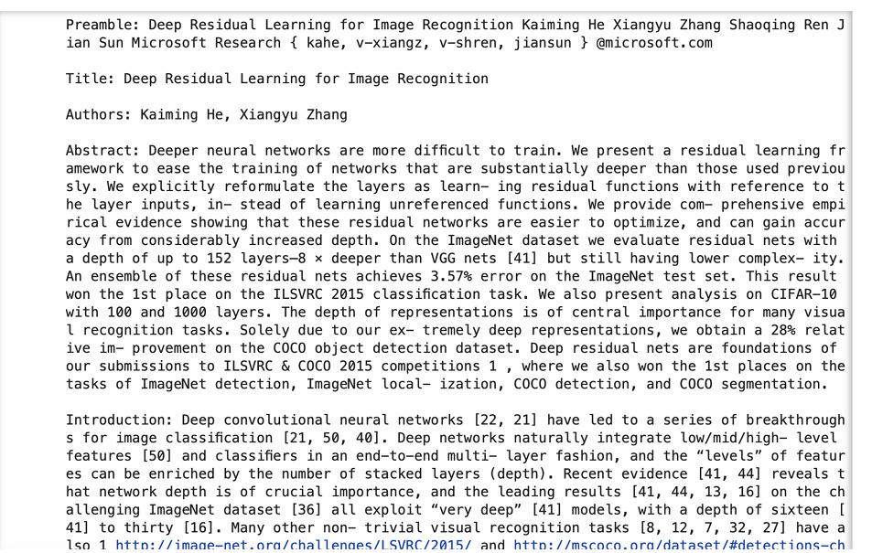
Text Extraction
Extracts full-text content from PDFs using PyMuPDF.
Identifies important structures like: Titles, Authors, References,Section Headings (via font size, style, numbering)
Organizes extracted content into structured dictionaries for efficient analysis.
Ensures no information loss while preserving document structure.
Extracted Raw Data
Labelled Structured Data

Slide 12
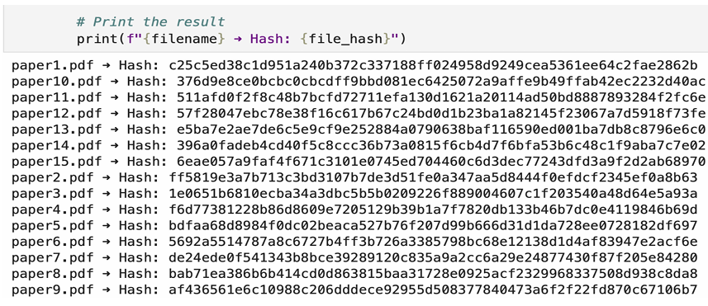
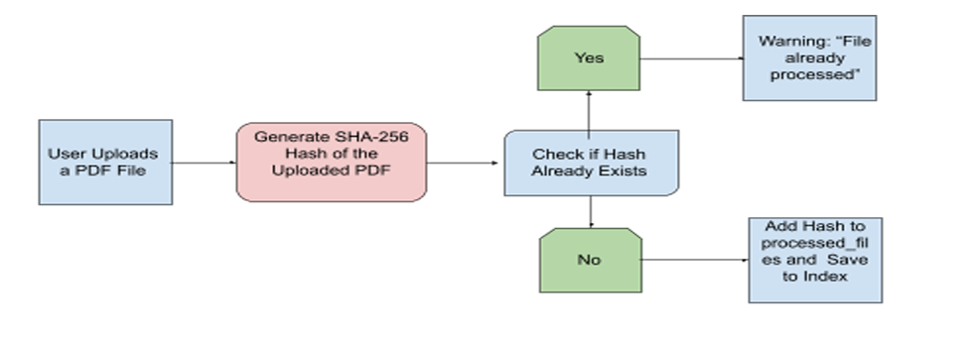
Hashing For Duplicate Removal
SHA-256 hashing ensures unique fingerprints for every PDF.
Prevents duplicate documents from entering the database.
Offers advantages over:
MD5, CRC32, and cosine similarity (which have higher collision risks).
Optimizes:
Storage space
Retrieval speed
Dataset integrity
Hash ID’s of PDF Files
SHA Flow Diagram

Slide 13
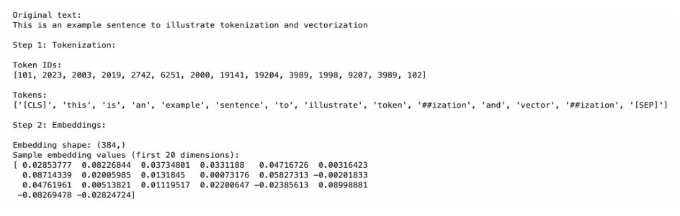
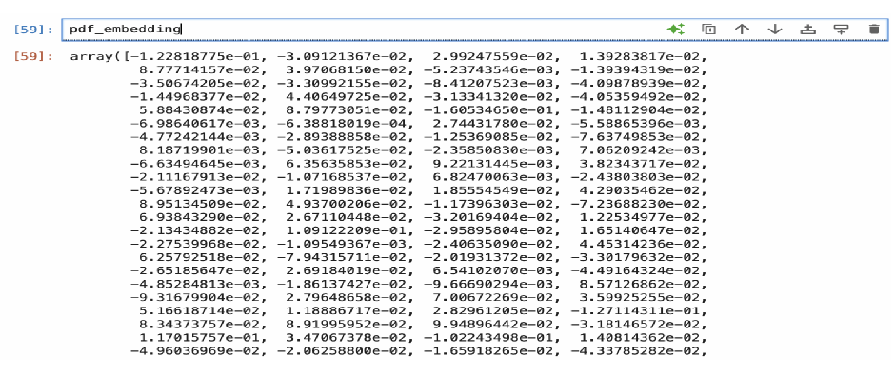
Chunking,Tokenization and Sentence Embeddings
Split the the whole pdf text into small chunks
Splits each chunks into subwords for better handling by LLMs.
Preserves semantic structure, especially useful for scientific texts.
Uses Sentence Transformers (MiniLM) to generate dense semantic vectors.
Converts each document into a set of semantically meaningful vectors for later search and retrieval.
Original, tokenized and vectorized text
Embedding for Whole PDF

Slide 14
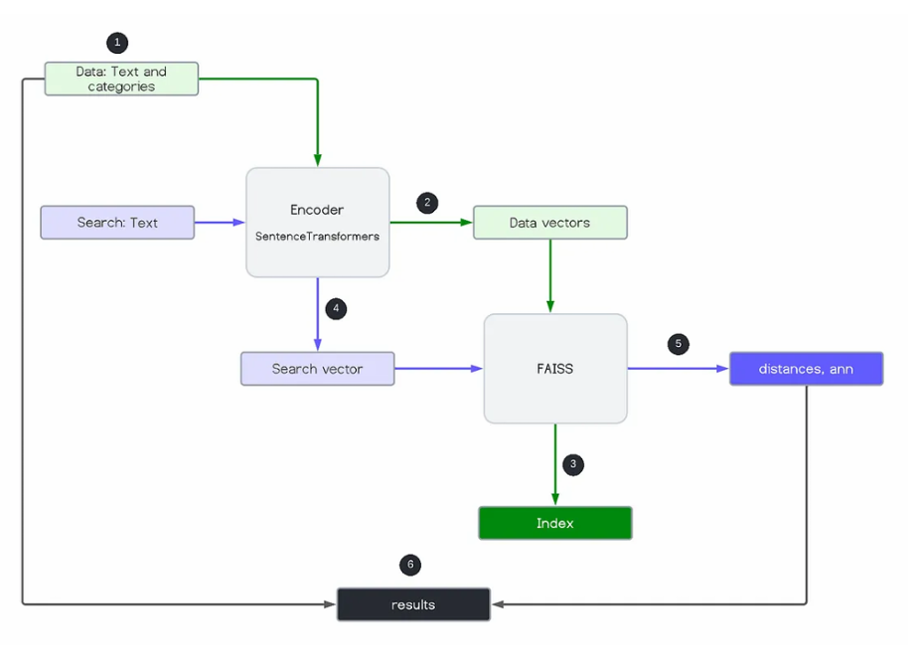
Vector Indexing–FAISS
Embeddings are indexed using:
Inverted File Index (IVF)
Hierarchical Navigable Small
World (HNSW) Graphs
FAISS Advantages:
Optimized for high-dimensional data.
Multi-GPU support for large datasets.
Outperforms alternatives like Annoy
and ScaNN.
Faiss Workflow Diagram

Slide 15
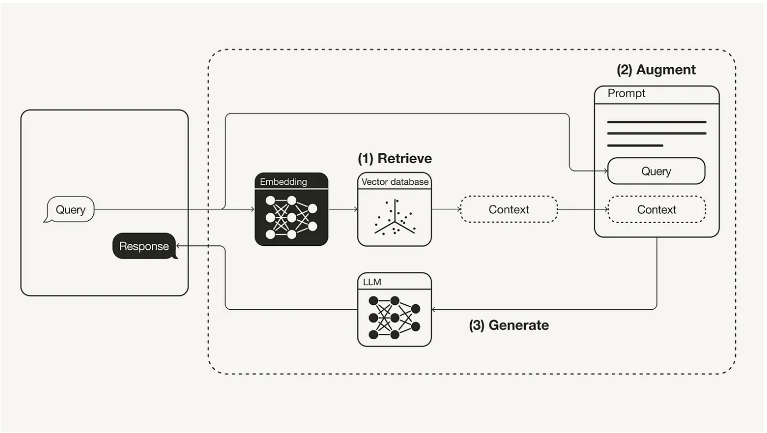
RAG Workflow Diagram
RAG Workflow Diagram
Query Input: The user submits a question or query.
Retrieve:The query is embedded and matched against a vector database (e.g., FAISS) to fetch the most relevant context or documents.
Augment: The retrieved context is combined with the original query to create a rich prompt.
Generate:The LLM (e.g., Llama, DeepSeek) uses the augmented prompt to generate a response based on both the query and the retrieved context.

Slide 16
Model Selection
Model | Developer | Parameters (in Billions) | Model Size(in GB) | Advantage | Possible Limitations
Llama 3.2 | Meta AI | 3 | 2.0 GB | Lightweight and highly efficient for fast retrieval | Due to less size it may have limited knowledge depth for complex research retrieval
Llama 3.1 | Meta AI | 8 | 4.9 GB | High retrieval accuracy, strong multilingual capabilities | High computational demand, requiring optimized inference
Mistral | Mistral AI | 7 | 4.1 GB | Low-latency response generation for efficient AI interactions | Limited reasoning depth
Qwen 2.5 | Alibaba Cloud | 7 | 4.7 GB | AI-driven automation, structured reasoning, and document processing | Requires fine-tuning for research document retrieval
DeepSeek-R1 | DeepSeek AI | 8 | 4.7 GB | Optimized for retrieval-augmented reasoning and knowledge extraction | Complex fine-tuning and moderate GPU needed
Gemma 3 | Google DeepMind | 12 | 8.1 GB | Highly scalable, supports multimodal retrieval and reasoning | High computational cost, challenging real-time deployment

Slide 17
Selected Evaluation Metrics
ROUGE (Recall-Oriented Understudy for Gisting Evaluation): ROUGE is a recall-based metric widely used for evaluating text summarization. It measures how much of the reference summary’s content is captured in the system-generated summary. ROUGE-1 (unigram overlap), ROUGE-2 (bigram overlap) and ROUGE-L (longest common subsequence)
BERTScore: It evaluates the quality of generated text by comparing the semantic similarity of each token in the candidate and reference texts using contextual embeddings from a pre-trained BERT model.
Summarization Time:Measures time to extract relevant content and generate summaries. The lower the time the better real time usability.
Word Count: Larger models may improve accuracy but increase computational cost. We balance performance and efficiency considering available resources.

Slide 18
Prompt Engineering
Prompt Number | Prompt Text
prompt1 | Summarize the following research paper:\n\n{text}\n
prompt2 | Provide a brief summary of this research paper, covering its problem statement, methodology used, the main results and conclusions\n\nPaper: \n{text}\n
prompt3 | Analyze the following research paper:\n\n{text}\n\nPlease deliver:\n 1. A simple breakdown of the abstract\n 2. A one-sentence description of the methodology\n 3. The key findings and their significance\n4. Any suggested future work\n
prompt4 | Analyze the following research paper with its structured sections:\n\n{text}\n\n Please provide:\n 1. A detailed breakdown of the abstract in simple terms\n 2. Provide the key references used in the paper along with their links and how they relate to the problem statement or solution\n 3. Any existing solutions—if yes, what makes this project stand out and how it improves upon existing literature\n 4. A concise summary of methodology or techniques used in brief\n5. Main results and conclusions and proposed future work\n

Slide 19
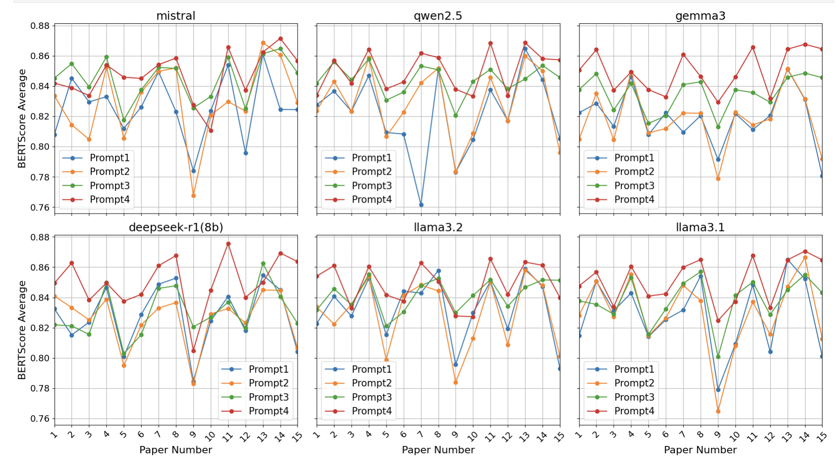
Prompt Engineering
BERTScore F1 between reference vs. generated summaries
Calculated for each of the 15 papers × 4 prompts × all models

Slide 20
Model Evaluation Results
Average performance metrics across 15 papers for each model
Model | ROUGE-1 | ROUGE-2 | ROUGE-L | BERTScore | Summarization Time (sec) | Word Count
Deepseek-r1(8b) | 0.4033 | 0.1516 | 0.2007 | 0.850337 | 46.1213 | 352.533
Gemma3 | 0.4127 | 0.1515 | 0.20462 | 0.849782 | 47.632 | 366.4
Lamma_3.1 | 0.38824 | 0.14501 | 0.1974 | 0.846775 | 81.265 | 330.066
Lamma_3.2 | 0.4053 | 0.15148 | 0.2011 | 0.850242 | 48.5833 | 371.2666
Mistral_Summary | 0.40865 | 0.15363 | 0.2034 | 0.851195 | 110.3953 | 370.0666
Qwen_2.5 | 0.4088 | 0.1489 | 0.1980 | 0.848448 | 104.5426 | 362.533

Slide 21
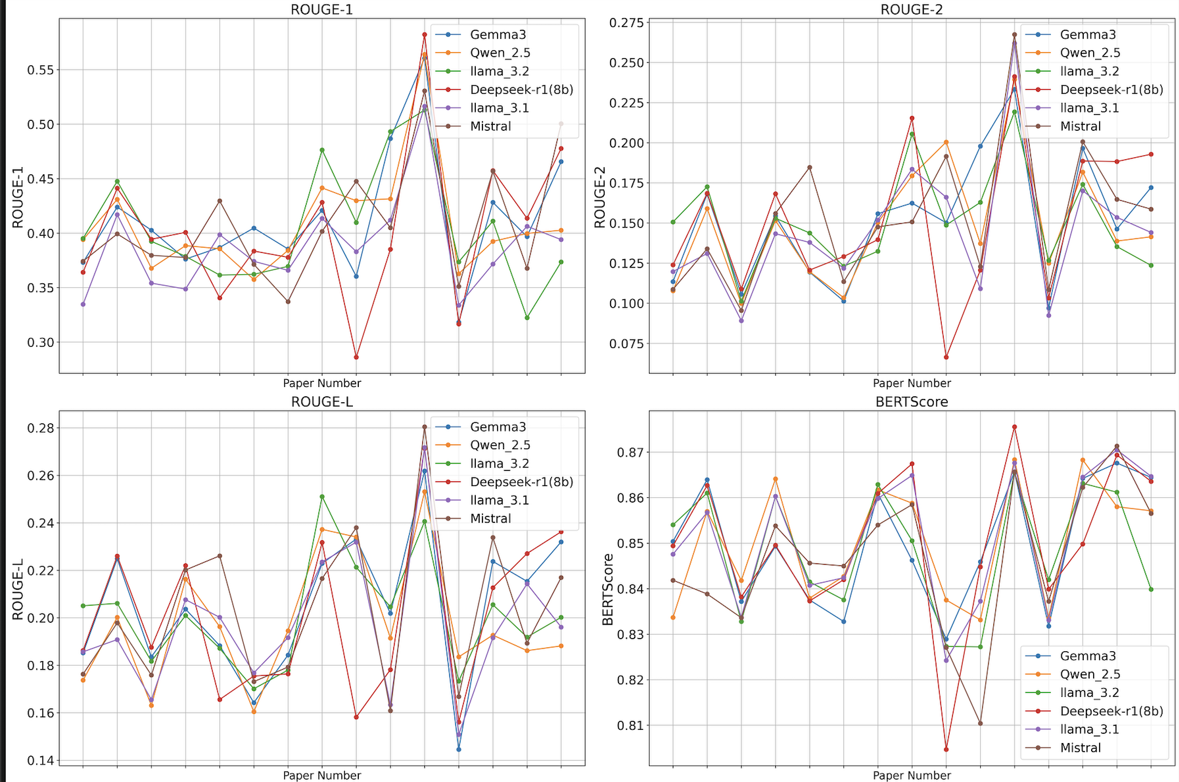
Model Evaluation line plots

Slide 22
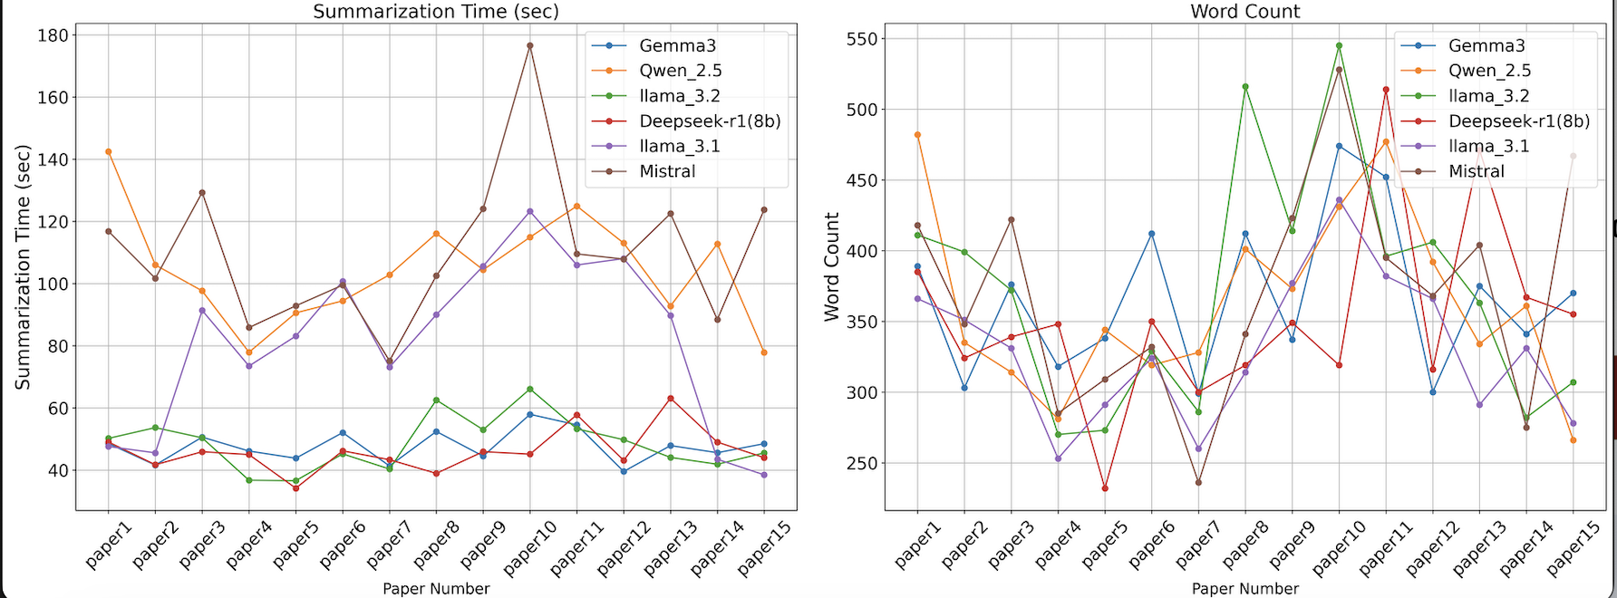
Model Evaluation line plots

Slide 23
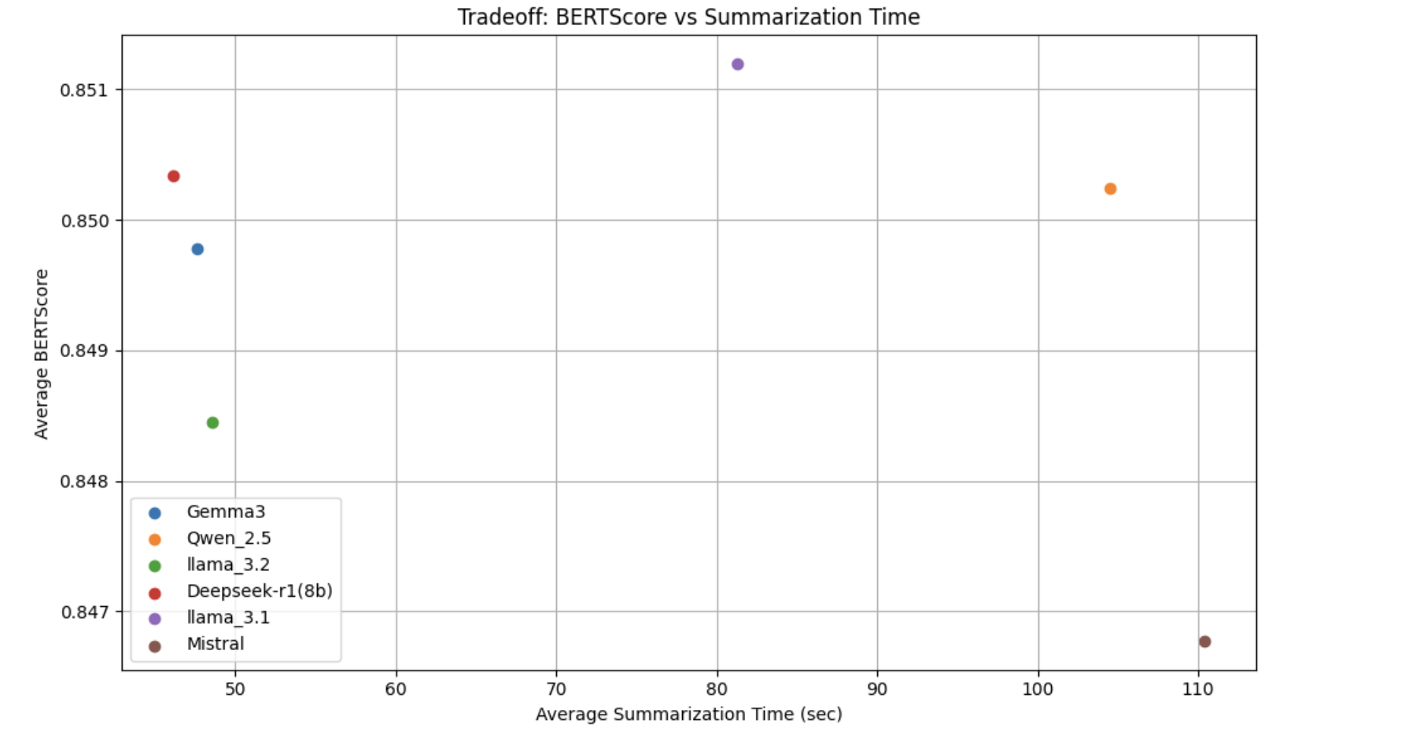
Statistical Analysis
Average BERTScore Vs Average Summarization Time(sec)

Slide 24
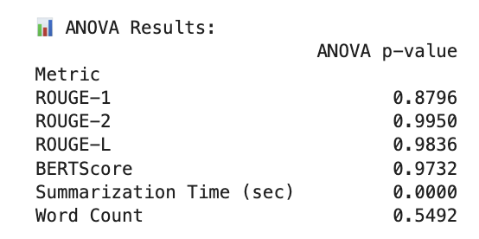
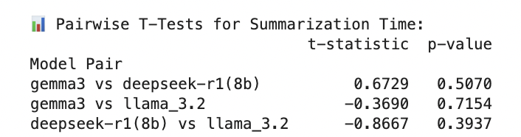
Statistical Analysis
ANOVA test
Significant difference observed only in Summarization Time (p < 0.05).
ROUGE & BLEU scores showed no significant variation.
Confirms DeepSeek-R1, Llama 3.2, and Gemma 3 are efficient candidates.
Pairwise t-Test
Compared DeepSeek-R1, Gemma 3, and Llama 3.2.
DeepSeek-R1 had the shortest processing time, but not statistically significant.

Slide 25
Statistical Analysis
Model Size Consideration
Gemma 3: 12 GB (High resource demand)
DeepSeek-R1: 4.7 GB
Llama 3.2: 2.0 GB (Lightweight and fast)
Llama 3.2 is preferred due to the balance between speed, efficiency, and system compatibility.

Slide 26
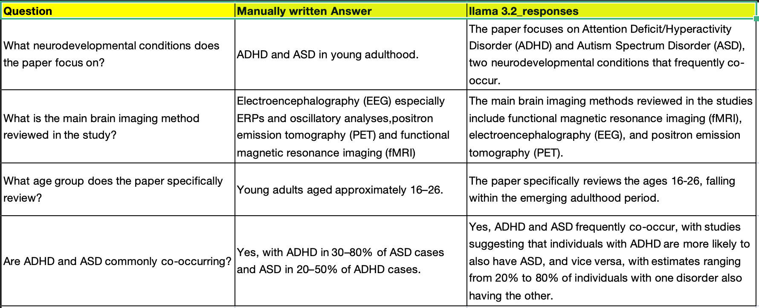
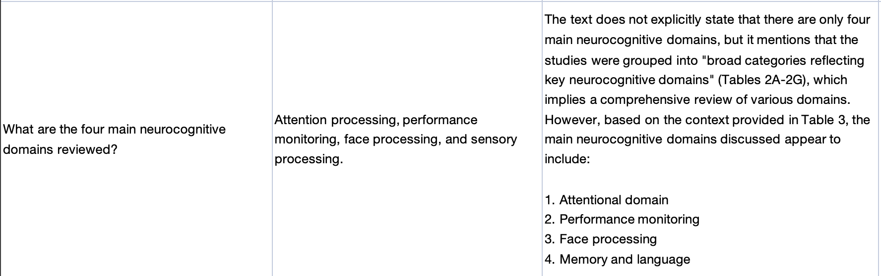
RAG Response Evaluation
225 total questions: 15 per paper × 15 papers
Questions are strictly factual (e.g., “What dataset was used in the experiment?”)
We drafted one-line reference answers for each
Evaluation focuses on the model’s ability to retrieve and state facts
195 / 225 questions answered acceptably → 87.5 % accuracy
Demonstrates Llama 3.2’s strong factual retrieval capability

Slide 27
Conclusion and Future Scope
Conclusion:
Structured & efficient AI system using RAG, FAISS, and LLMs
Locally deployable — ensures full data privacy
Combines fast retrieval, smart preprocessing, and adaptive model selection
Validated with ROUGE, BERTScore, and latency metrics
Improves literature review automation and research productivity
Future Scope
Fine-Tuning: Fine tune the LLM’s using domain-specific datasets for improved contextual understanding
UI Enhancements: The user interface will be upgraded to support multi-query history and citation-aware highlighting.
Further Improvements: Advanced prompt engineering will be explored to make the system adaptable across diverse research domains.

